Slide 1
The SCARAB
Stuart Rossiter
C00284845
October 2025

Slide 2
Overview
What is it?
What’s the problem it aims to solve?
What does the device entail?
What does the PC program entail?

Slide 3
SCARAB
Modular Game Cartridge Health Checker and Save Manager.
Allows checking of hardware, such as cartridge pins, save retention
Interfaces with a PC program.
Stores saves as files on PC.

Slide 4
Problem
Hardware decays over time
Issues go undiscovered
Focus is primarily on software preservation
Retro cartridges need help
Too much variety of cartridges

Slide 5
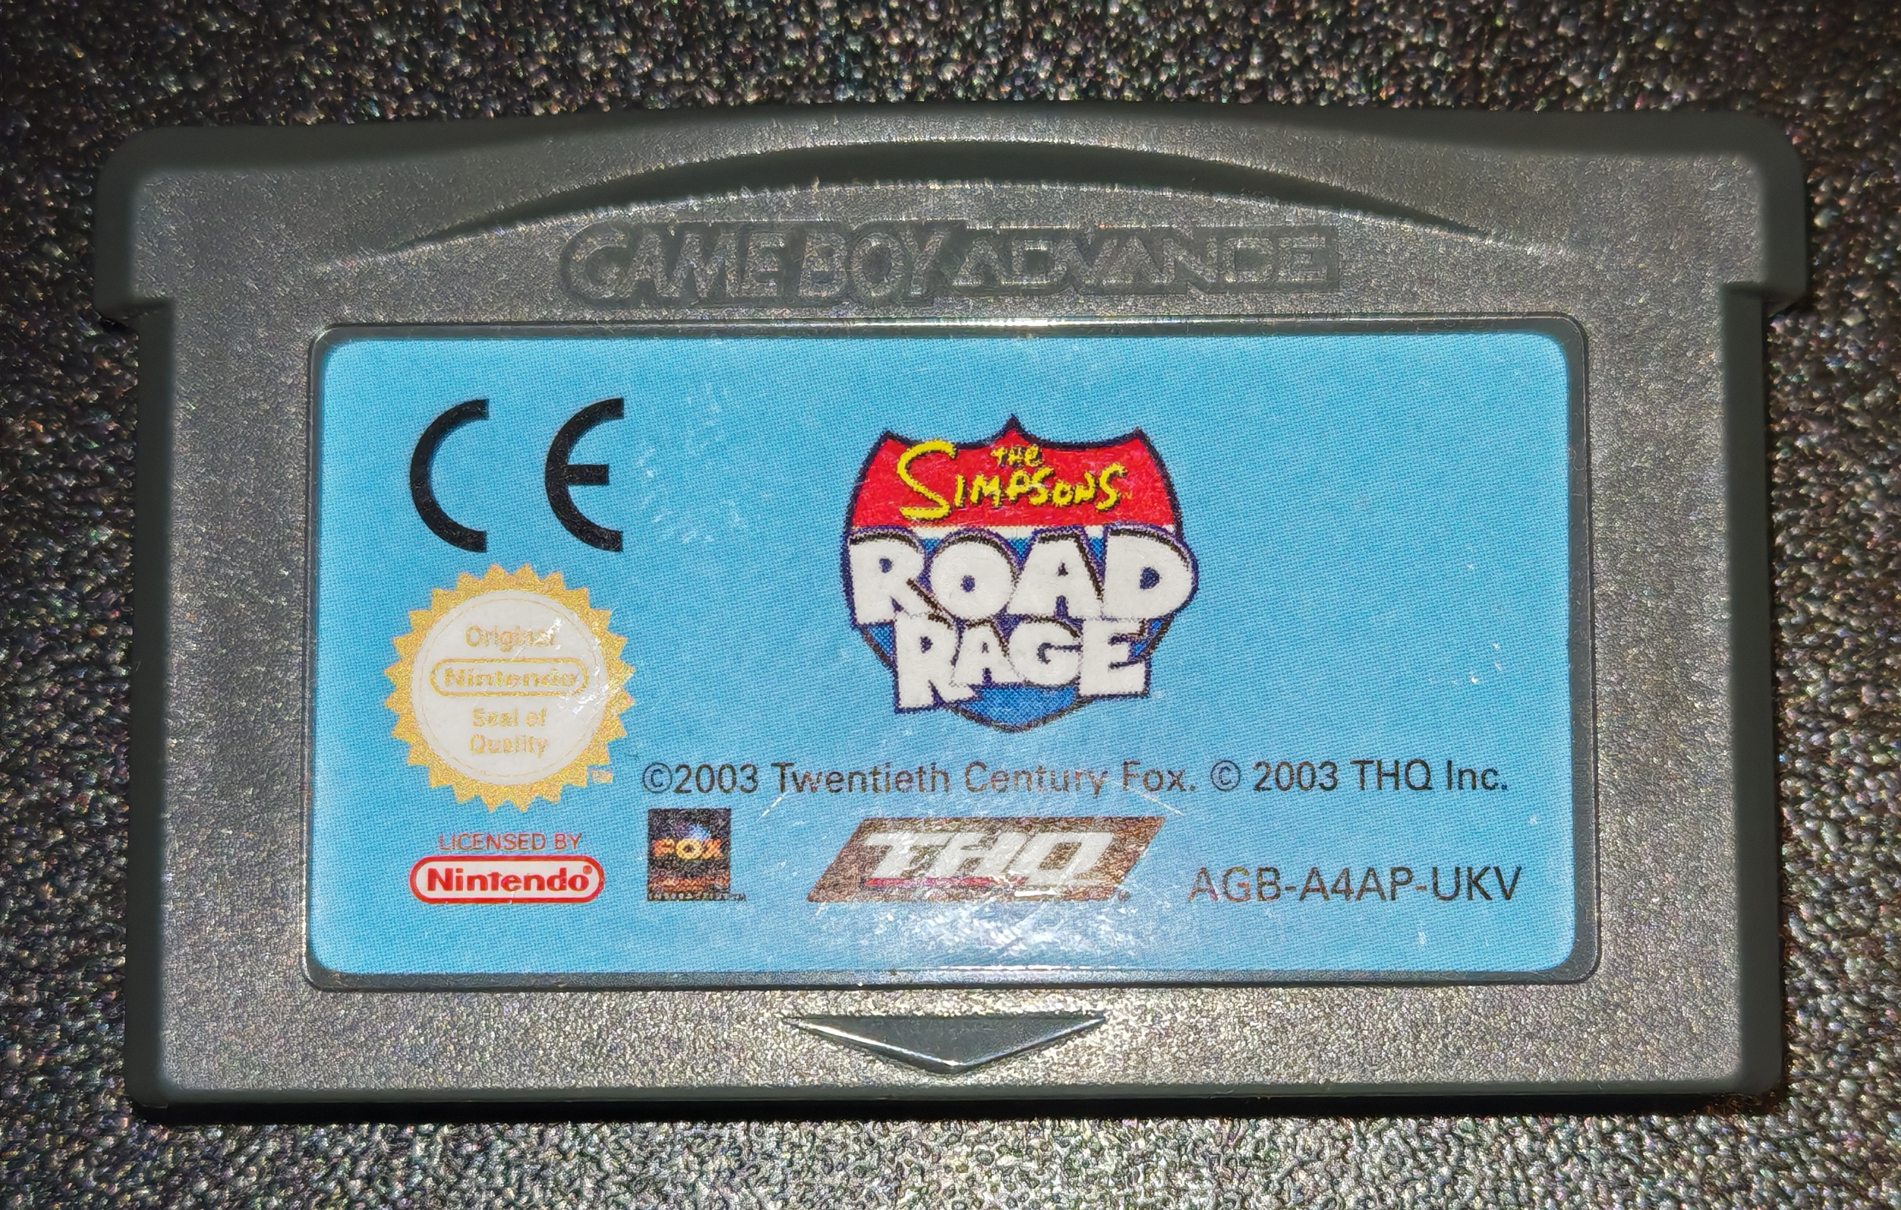
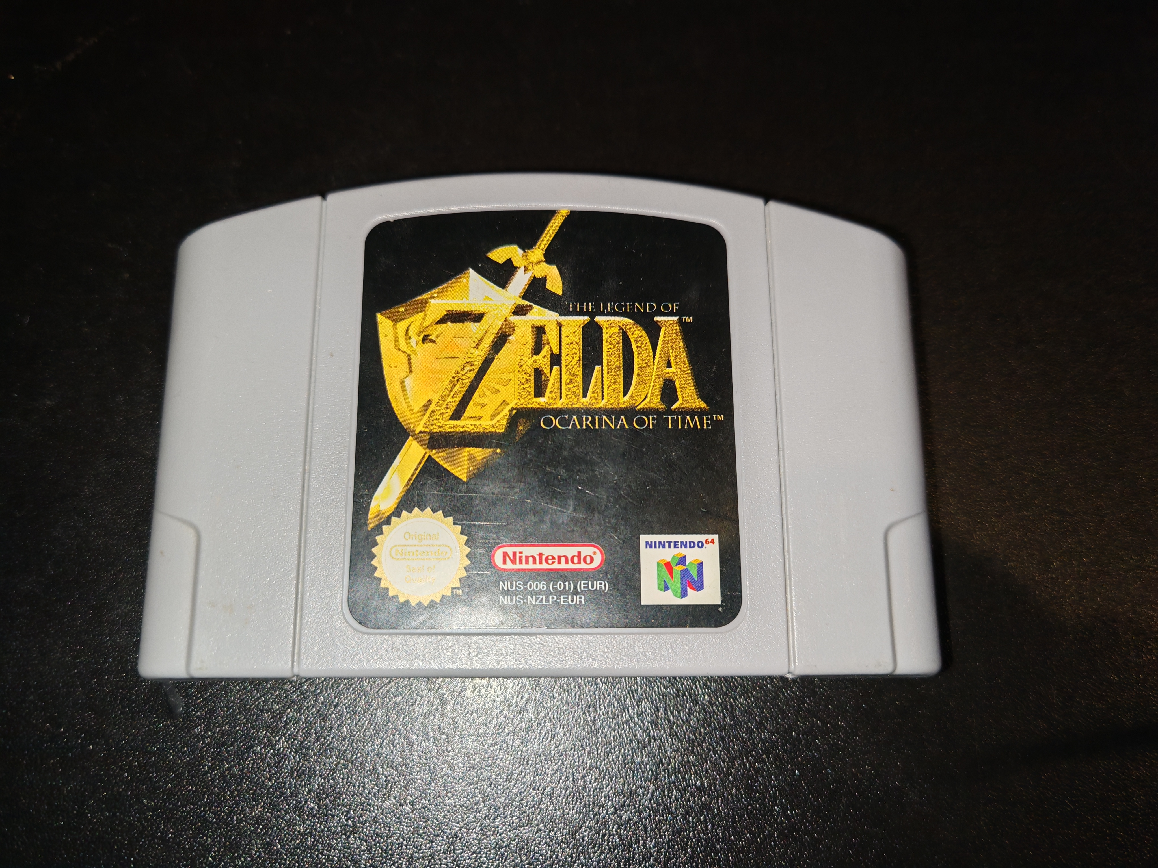
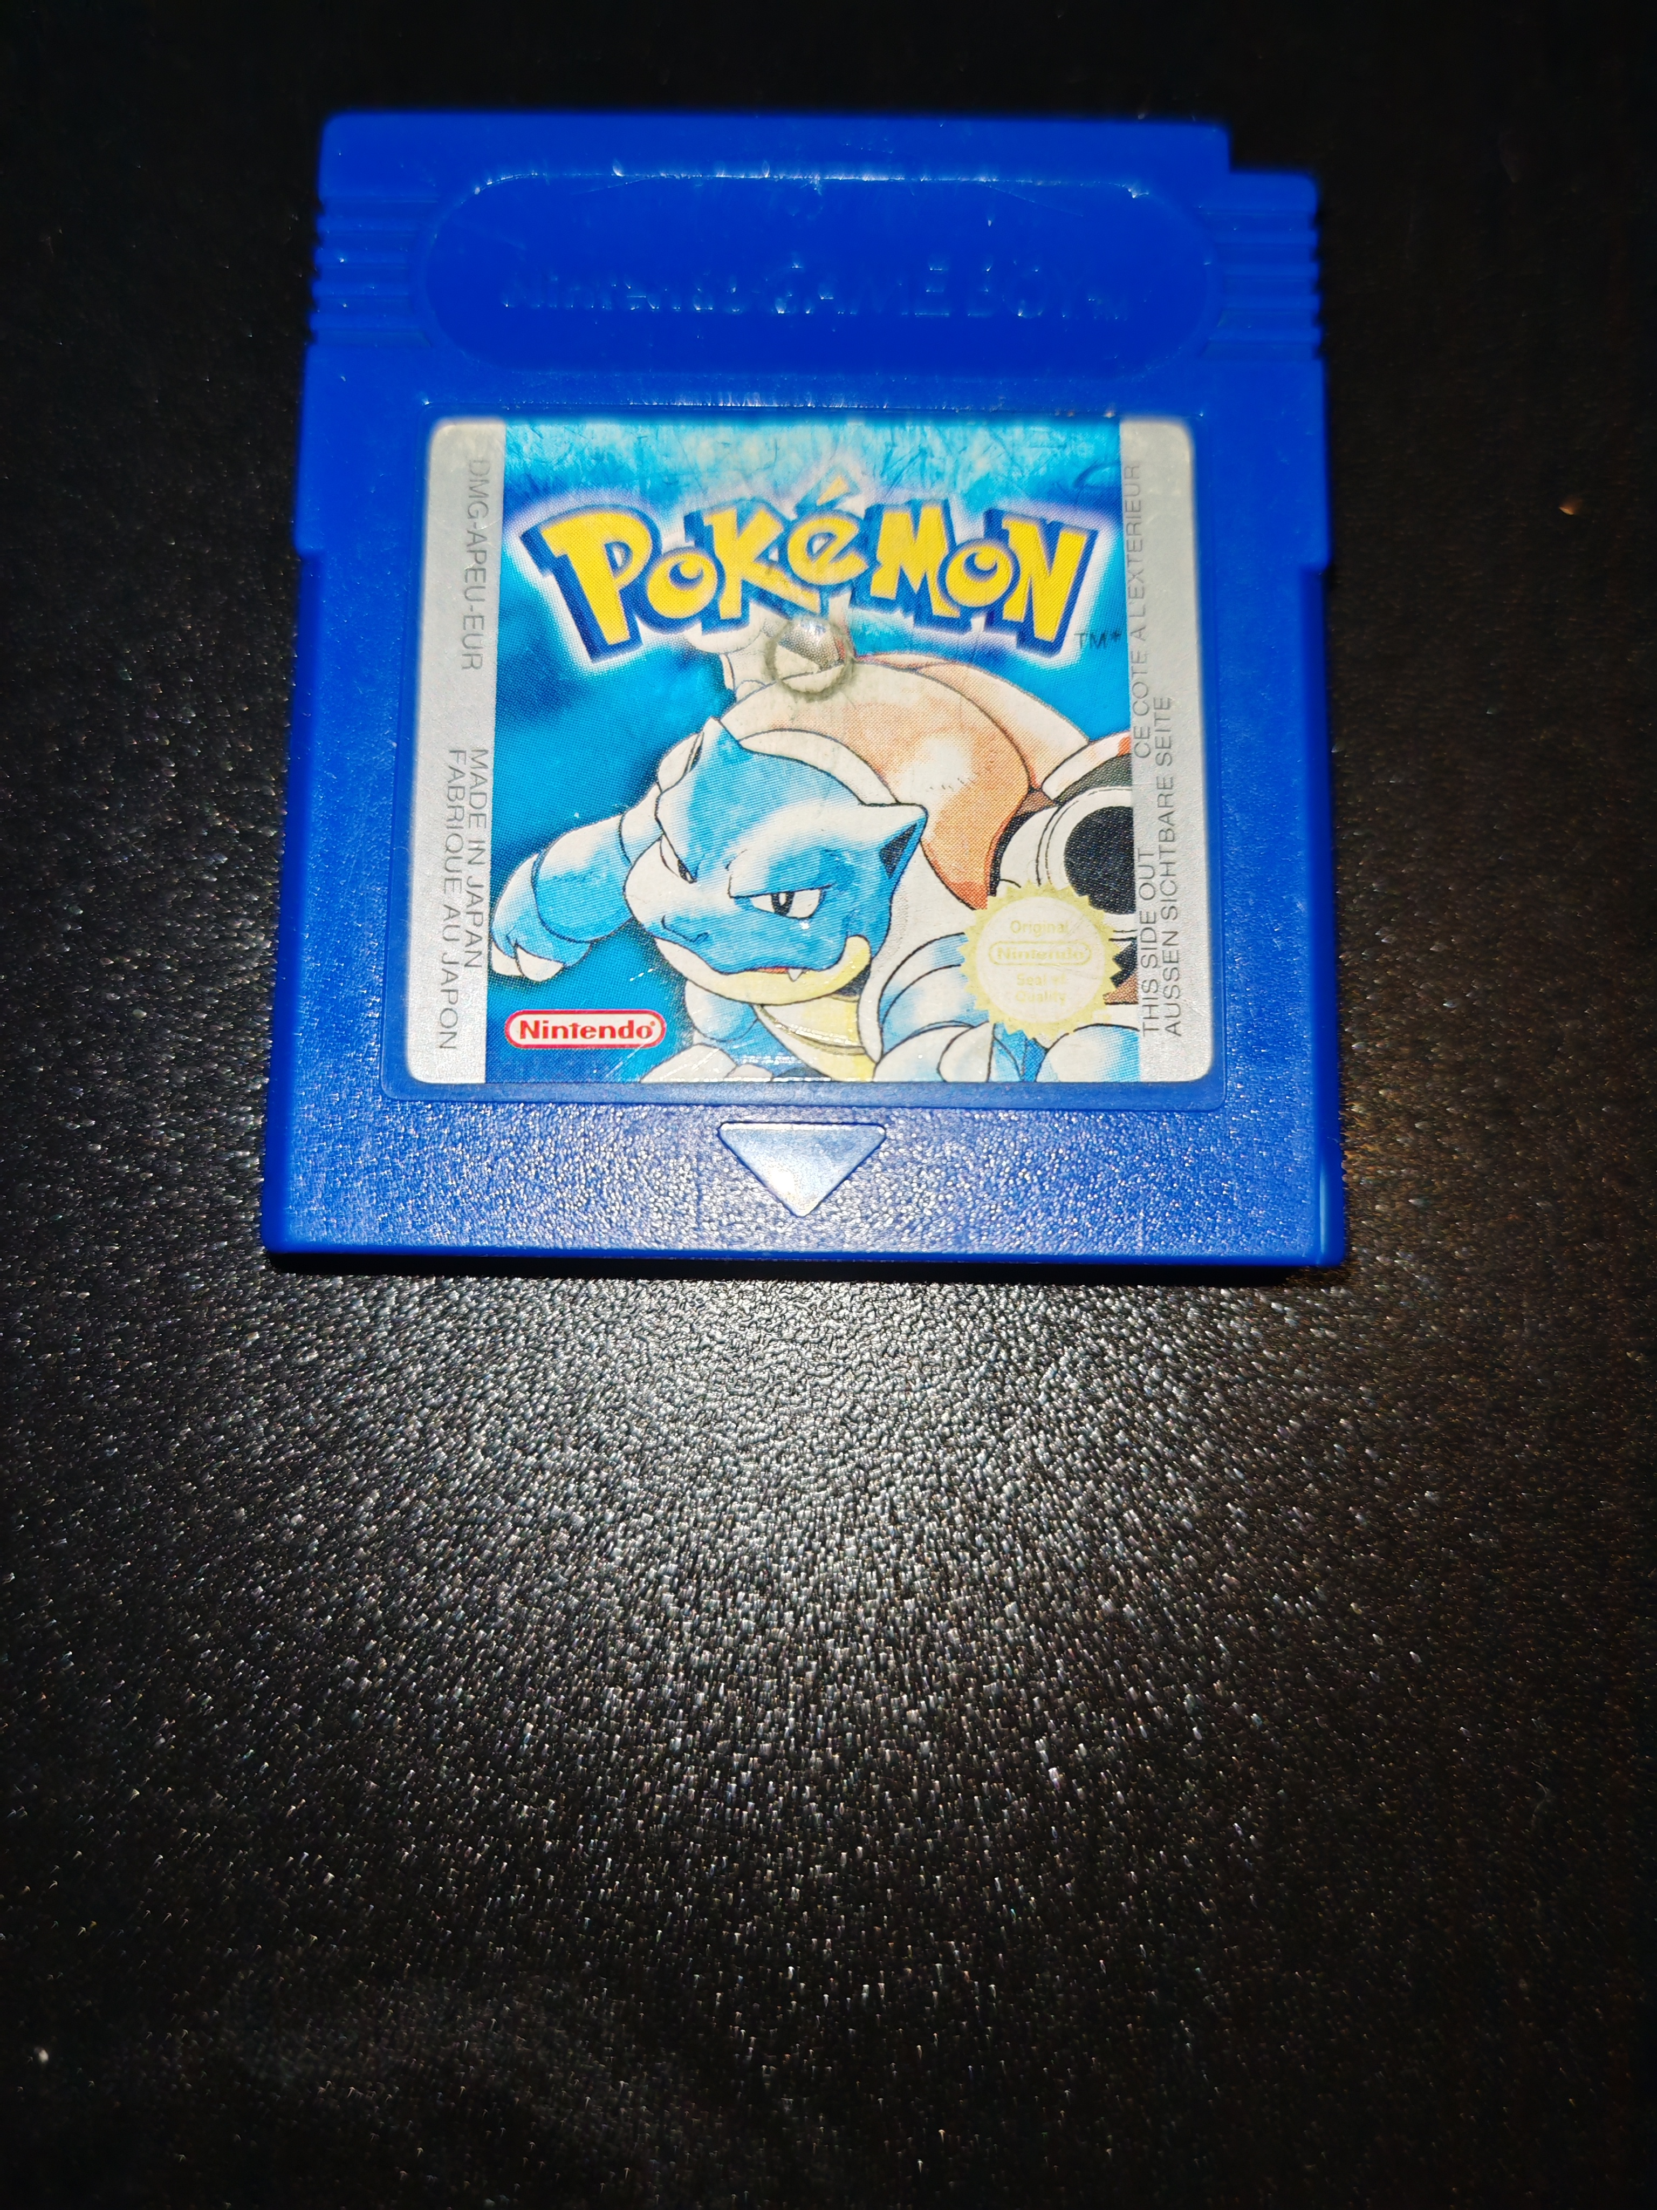
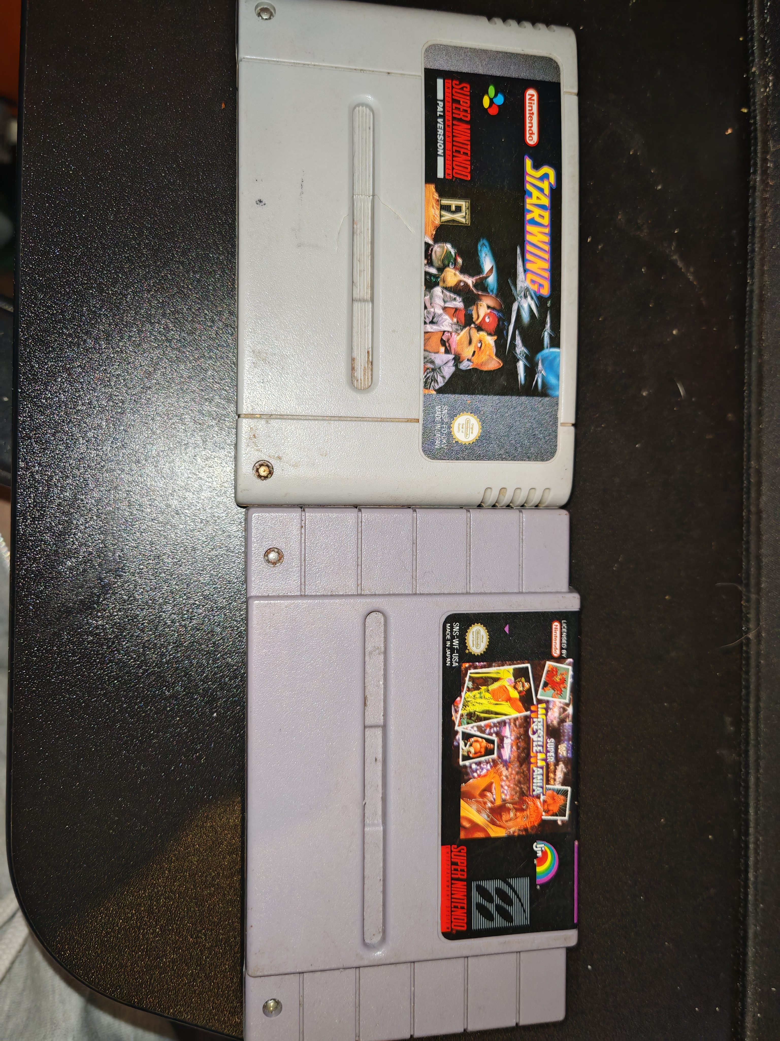
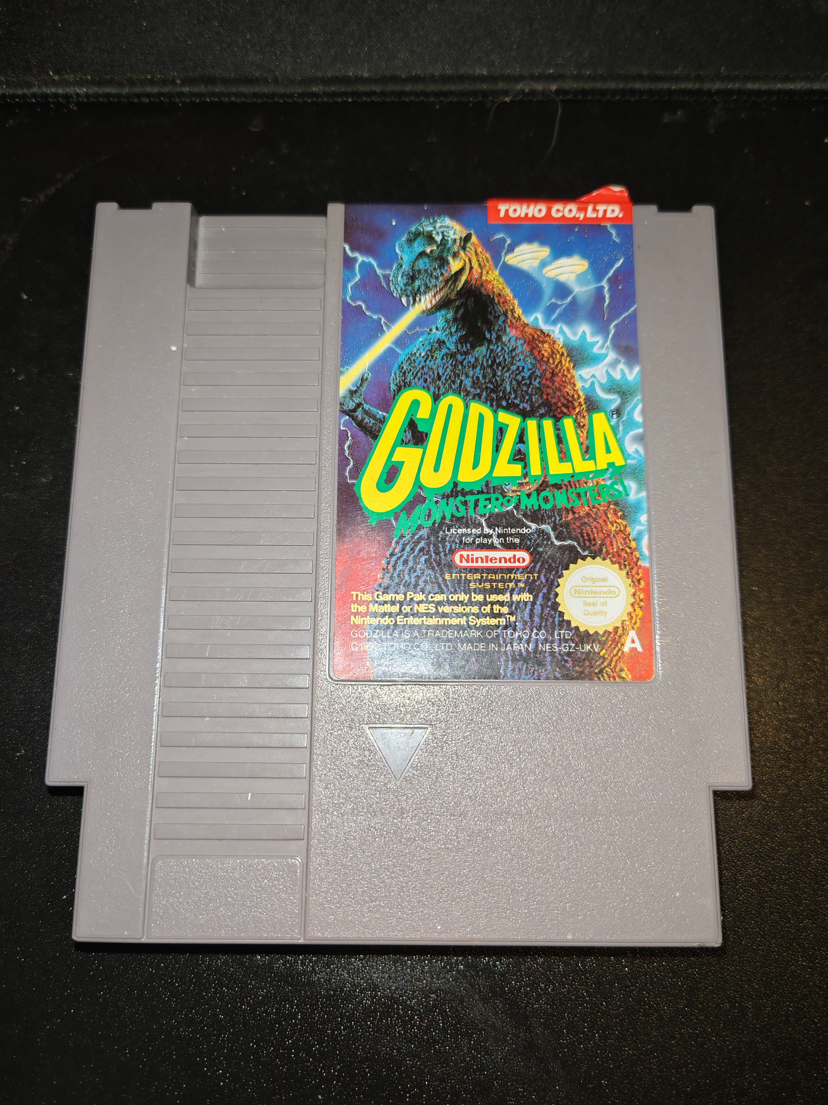
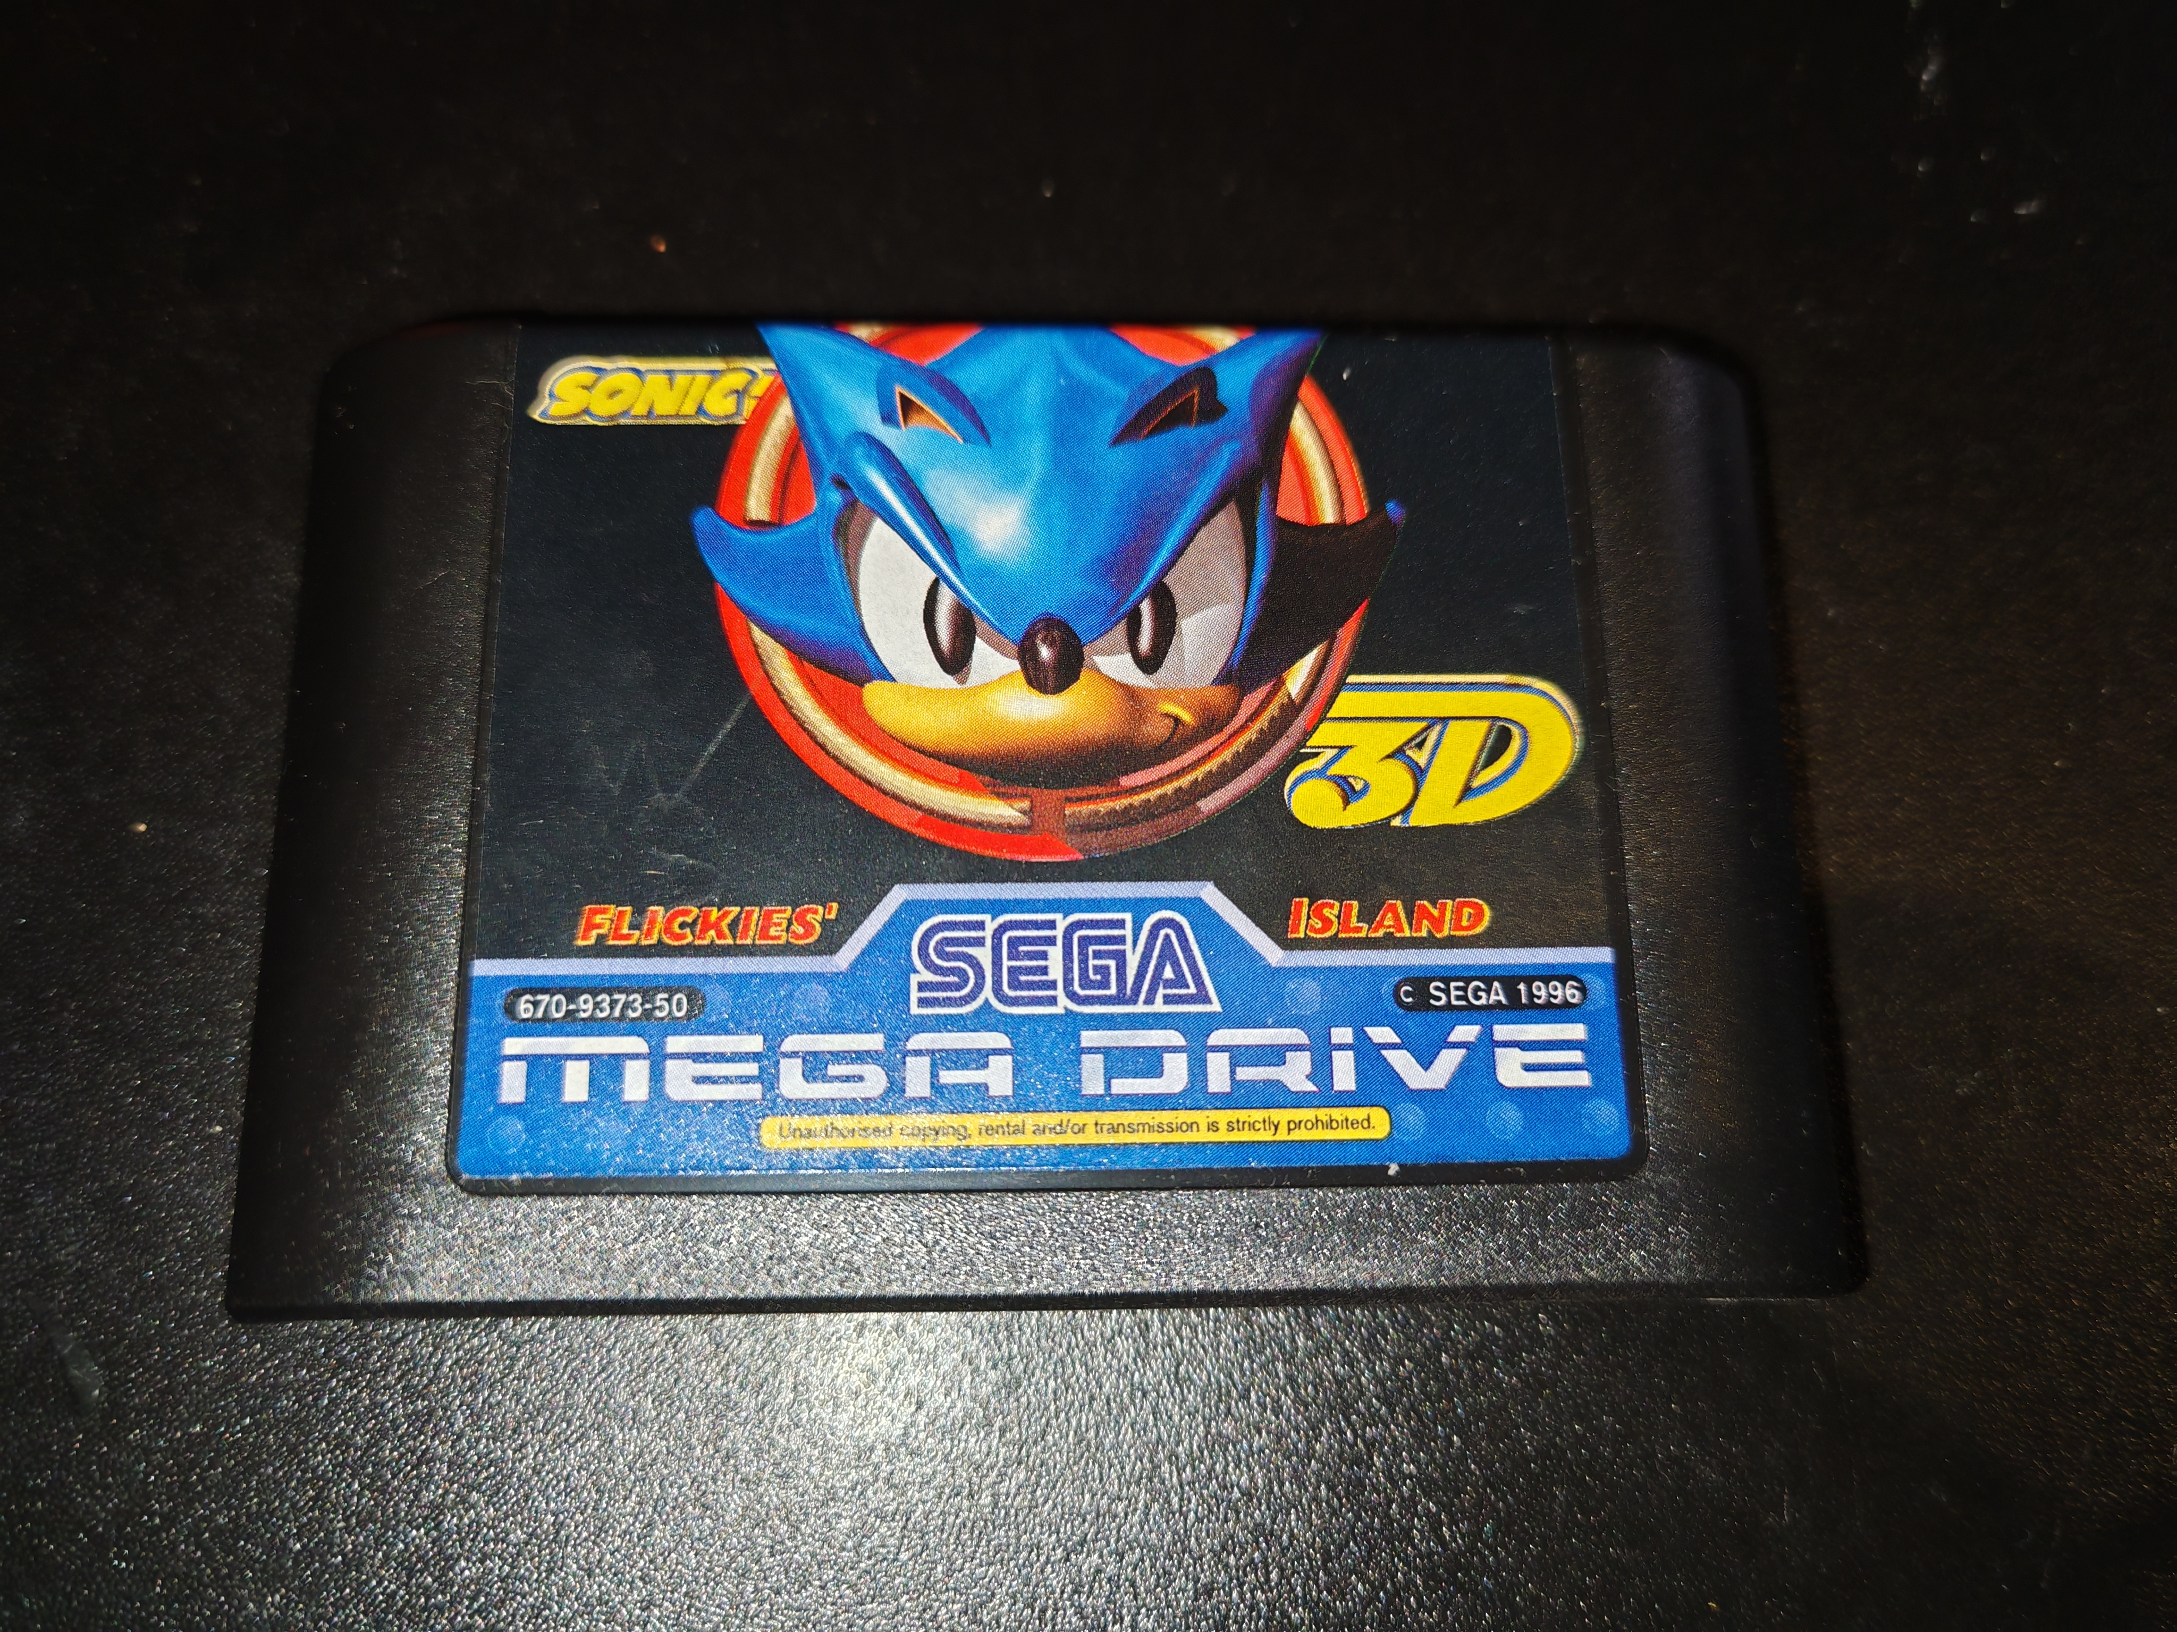

Slide 6
SCARAB Device
Modular Design
Cartridge Port Modules
Powered by Arduino Mega 2560
Dumps and Restores Save Data
Tests Pins
Validates Checksums
Tests Save Data Retention
Identifies Corruption

Slide 7
SCARAB PC Program
Interfaces with the SCARAB Device
GUI Based
Stores and Manages Save Data

Slide 8
Questions?

